Slide 1
Blind estimation of acoustic transfer functions (ATFs) and dereverberation based on convolutive transfer functions (CTFs) Date：2024. 05. 29
Telecom Electroacoustics Audio(TEA) Lab
Presenter:
Anchi Yuan
Notes:
Hello everyone
I’m today’s presenter siang. I’m going to share some of my present work in source separation problem. My topic is comparative studies of source separation using semi-blind and blind source separation approaches.

Slide 2
Outline
麥克風固定件
實驗設置照

Slide 3
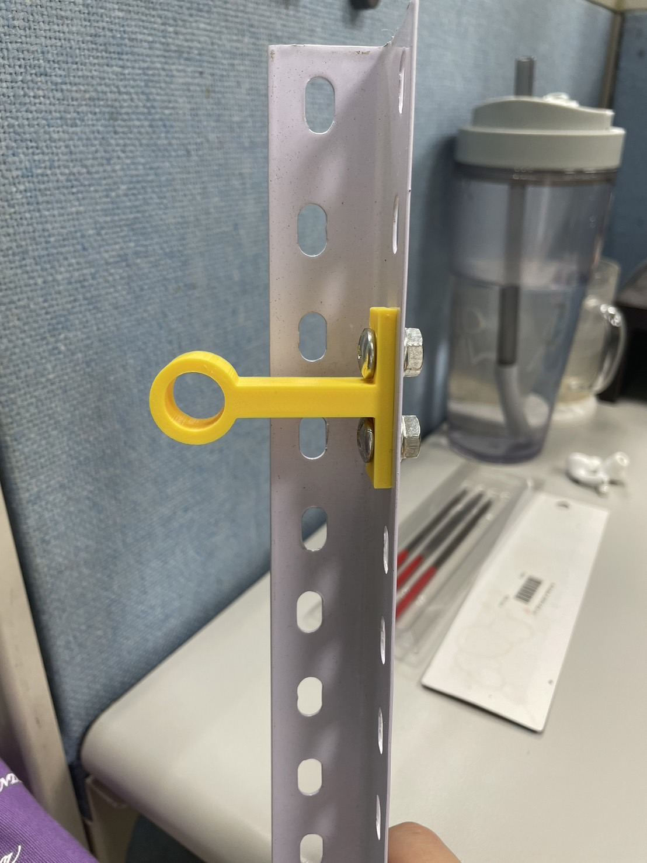
麥克風固定件

Slide 4
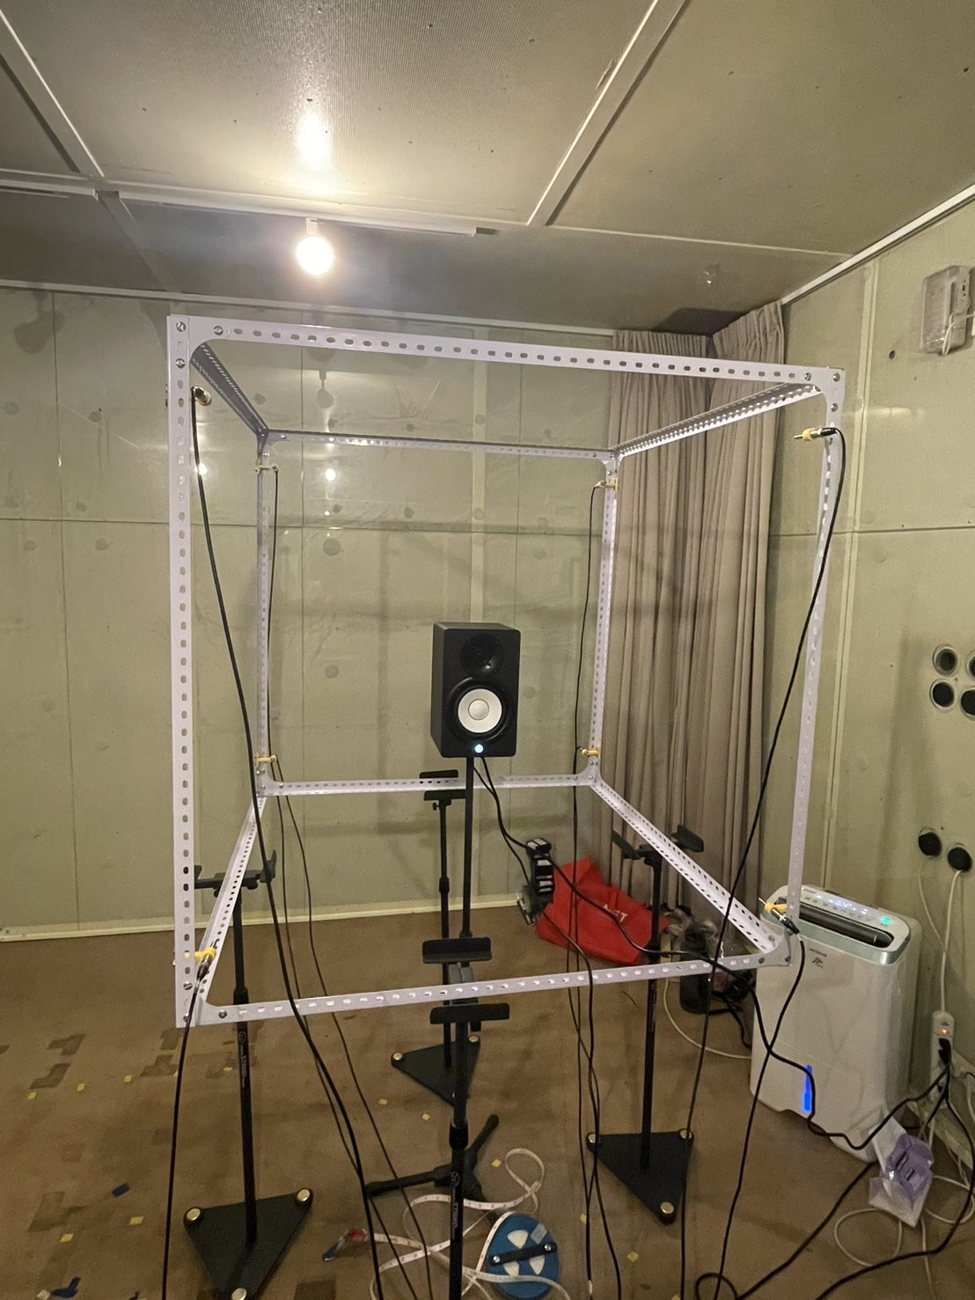
實驗設置照

Slide 5
